Slide 1
Project 2
Team: Luan, Tianqi & Wang, Jingjing

Slide 2
Team information
Leader’s Name: Luan, Tianqi
Project Name: MBTI test
Description: MBTI 16 personalities test
Team member: Tianqi Luan, Jingjing Wang
Luan, Tianqi: user, designer, programmer, tester
Wang, Jingjing: user, designer, programmer, tester

Slide 3
User
A one-stop, easy to use personalities test based on MBTI 16 personalities theory
All users need to sign-up first to get to the test
Return users can directly login
User will be asked a series of questions in limited amount of time
The result will be displayed instantly after submitting
All test results comes with a small breakdown

Slide 4
Design
Frontpage
Login
Sign-up
Login submit
Sign-up submit
Test
Logout
Logout submit
Result

Slide 5
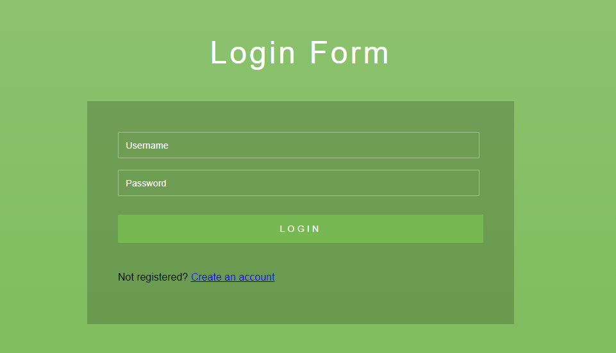
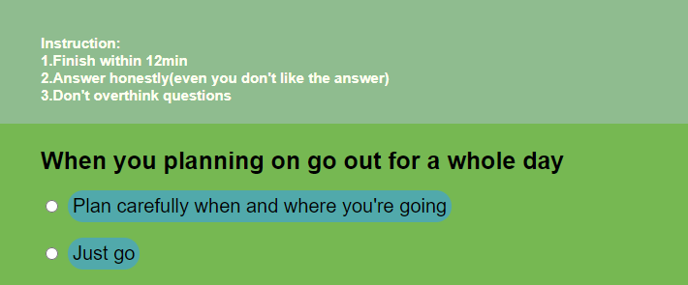
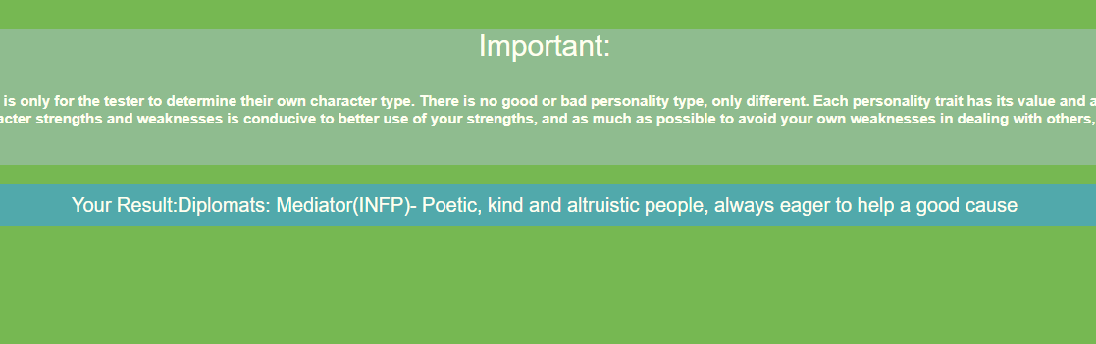
User interface
Frontpage
Sign-up, login, logout
Test
Result

Slide 6
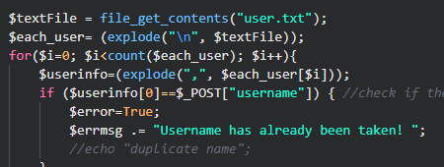
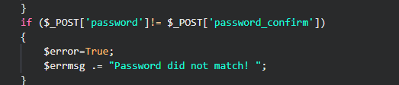
Some codes (input verification)
Read the user file in user.txt to verify
if the username is still available
A for loop go through all users
Match passwords user put in

Slide 7
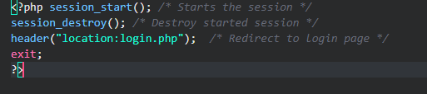
Session start & ending
A session is started every time a
new user login/sign-up
The session would continue if left
with nothing done once the next user
logs in even being not the same user
A session_destroy() function is
added so the session get erased once
the user logs out

Slide 8
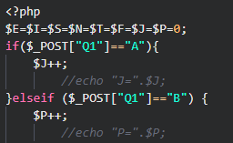
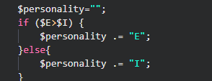
Algorithm
The 16 personality is consist of 4 characters:
E/I,S/N,T/F,J/P
Questions are all devoted to one of the characters and variables are accumulated each time certain answer is picked
Since questions have only two answers, comparison between which character is more appropriate can be done by simply compare which character’s answer is chose more

Slide 9
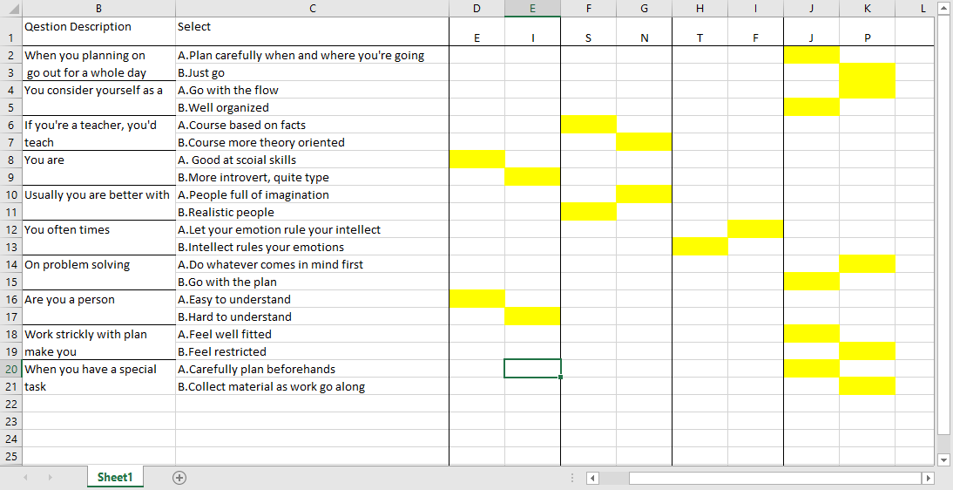
Demo run

Slide 10
Demo run

Slide 11

Test process
On our test run we also run into the session only work on local server issue, the method posted on discord group was tested but did not solve the issue
Further debugging is required to make the website run smoothly on CODD server

